Slide 1
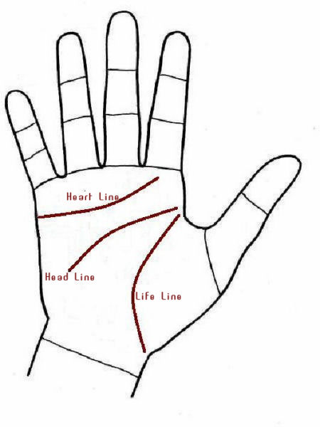

PALM PREDICTION SYSTEM
JIIT (PART 1)
MAJOR PROJECT

Slide 2
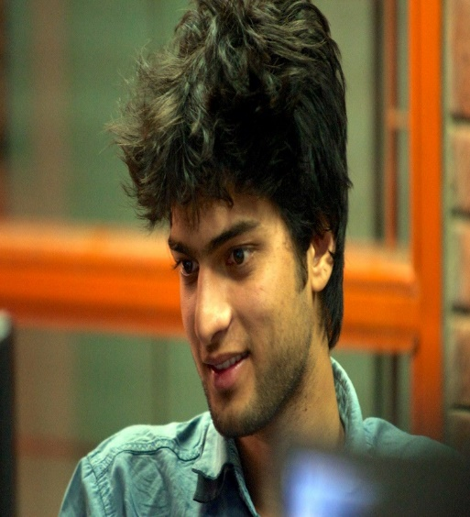

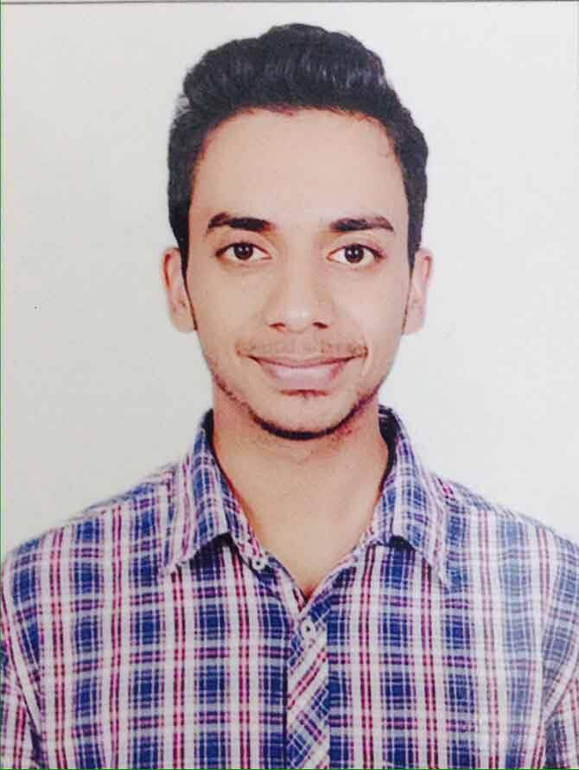
We made it possible..
Sumit Bansal
JIIT Noida
B.Tech
12103530
Vrishti Gahlaut
JIIT Noida
B.Tech
12103528
Aman Singhal
JIIT Noida
B.Tech
12103509

Slide 3
Motivation
Our College – Jaypee Institute of Information Technology
Dr. Manish Kumar Thakur– Mentor
Our passion for making and idea come to life
Dedication towards Coding

Slide 4
What is our Project about?
The Project titled “Palm Recognition System” with the aim of implementing key concepts in Data Mining was found to meet all objectives. Utmost care has been taken to see that the results obtained are true and the underlying procedures are implemented in true form. The aim of this project is to present a novel software based selection method that can be used by anyone to get predictions by scanning only the image of their hands. It provides a User-Friendly way to select the lines they want to interpret for future predictions. We have used as our basic and core algorithm for computing and predicting the result. The proposed method will provide a novel way to read lines in an affective budget friendly way.Also it focuses on validating the already existing rules of palmistry!!

Slide 5


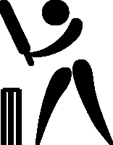

Limitations..
 | Not possible if previous data not available.
 | User must be familiar with basic lines of palmistry
 | Only file in txt format compatible.

Slide 6
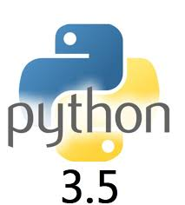
Technology used

Slide 7

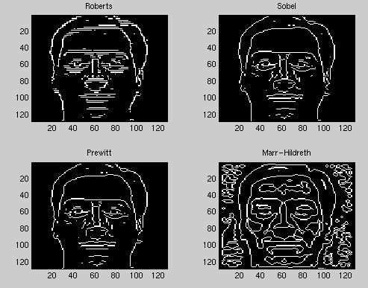
Project overview
Read Image.
Digitalize and filter
Edge and Line Detection
Data mining and prediction

Slide 8
Project Schedule
Task | Start Date | End Date | Duration (hours)
Information Gathering | 20/08/2015 | 30/08/2015 | 5
Test planning | 1/09/2015 | 15/09/2015 | 8
Test Case Development | 1/10/2015 | 15/10/2015 | 10
Test Execution | 18/11/2015 | 30/11/2015 | 20
Implementation | 01/12/2015 | 22/11/2015 | 50

Slide 9
Control Flow Diagram
<<extends>>
<<extends>>
<<extends>>
Add the scanned image of hand and enter details.
Edge detection ,filtering and calculating the pixels.length and width.
Cropping the area you want to know about.
Calculating ratios and
Searching for the category in which they fall and predicting.
View the prediction and add or reject the data accordingly.

Slide 10
Research Paper:Application of Digital Image Processing and Analysis in Healthcare Based on Medical Palmistry
In this paper, an application of digital image processing and analysis techniques has been discussed, which can be useful in healthcare domain to predict some major diseases for human being. Discussion on the steps involved in image processing is given.Also a short description on patterns important in palmistry is published.

Slide 11
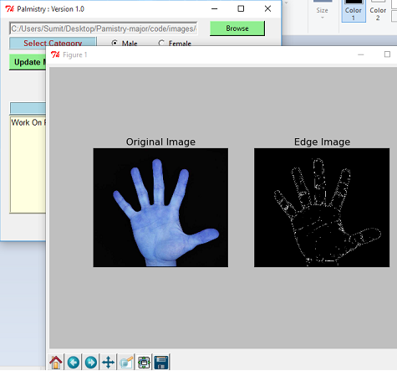
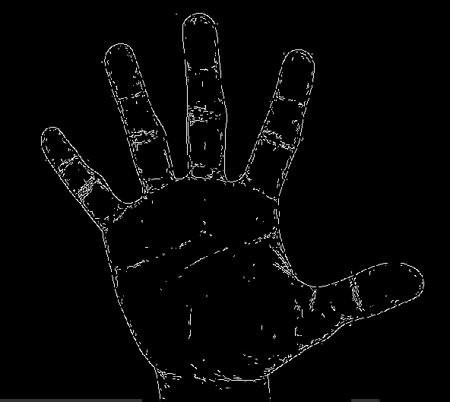
Canny Edge Detection Method Applied:

Slide 12
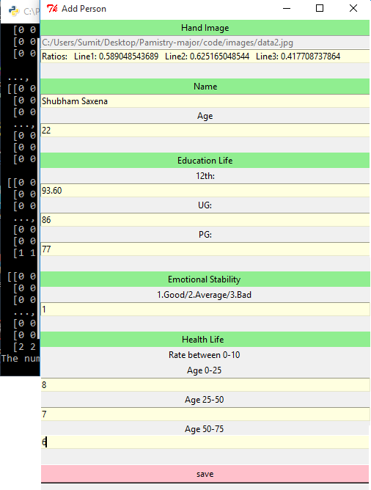
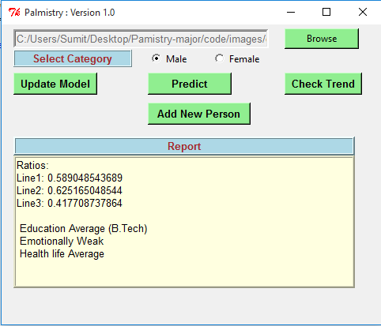
Output after the Implementation of Prediction Algorithm

Slide 13
Objective
Palmistry deals with studying the lines ,their lengths and ratios. As stated earlier in older times the manual calculation of ratios was not always correct .Let alone common man could not differentiate the frauds from the learned .The validation of any universal rule made during the ancient time does not exist even in the modern time. The problem is “Pattern Classification in the field of palmistry and validation of traditional rules.”

Slide 14
IMPLEMENTATION
Data Collection
Cluster Formation
Range detection
Ratio Calculation
Prediction
Validation

Slide 15
Approach
We will solve the problem in various steps starting from data extraction, data sorting, classification, calculating ratios and finally making predictions. There have been a lot of work done in this area but each research is majorly based on three lines-education, head and brain line. Then we predict that this ratio is good ,average or bad on the basis of previous data. If the prediction correlates with the reality the rule for prediction is validated however if it does not it proves that not all rules of prediction are precise.
Until now no one has made efforts to validate the rules of palmistry and thus this branch of astrology has always been a victim of faith despite being accurate a lot of times. We will apply data mining algorithms to calculate the clusters inorder to decide the ranges and predict about performance in that particular area.

Slide 16
Conclusion
Predicting human’s past ,present or future hundred percent accurately is an impossible task. Data mining algorithms can only predict it accurately to some extent. Also not every predicting rule is error proof.This newly developed model could help to validate the accuracy of each rule.Until now palmistry did not have a solid data set to prove if it correct but now slowly and gradually as the data set increases new trends will come into action. It is a simple and an accurate mathematical approach used for classification of ratios into good,average or bad category. This model will provide a mathematical fact for the fixation of certain value for a particular rule and also apply it . Not only will palmistry gain trust of people it will also be recognized as a mainstream research area with some solid results to back up the predictions.It will also save people to hire any astrologer ,rather they can do this on their own ,which also saves them from frauds and fake astrologers.

Slide 17
Future Work
Validating more lines and rules.
Increasing the dataset of already explored ones.
Making plots more insightful for better comparisons.
Making system more robust and scalable. More techniques for the visualization for the results.

Slide 18
Thank You

